Slide 1
Handy Helper Github
https://github.com/curtmorgan3/handy_helper

Slide 2
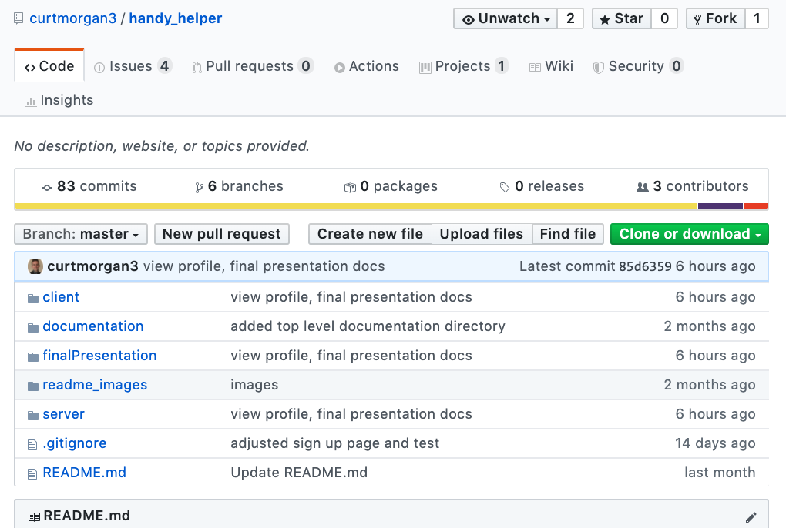

Slide 3
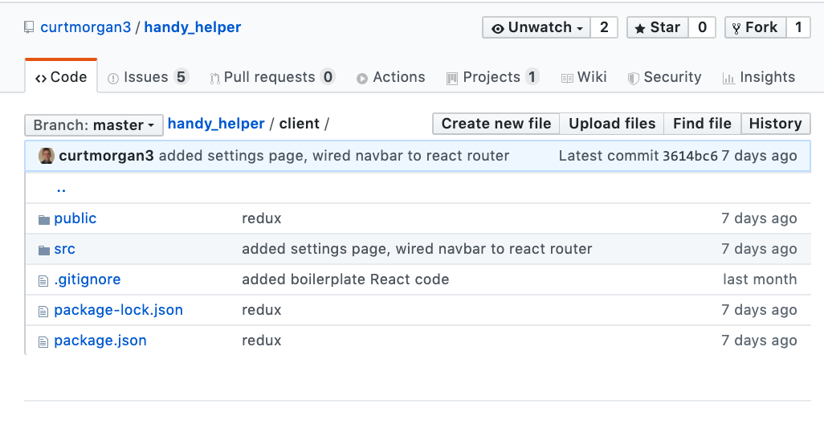

Slide 4
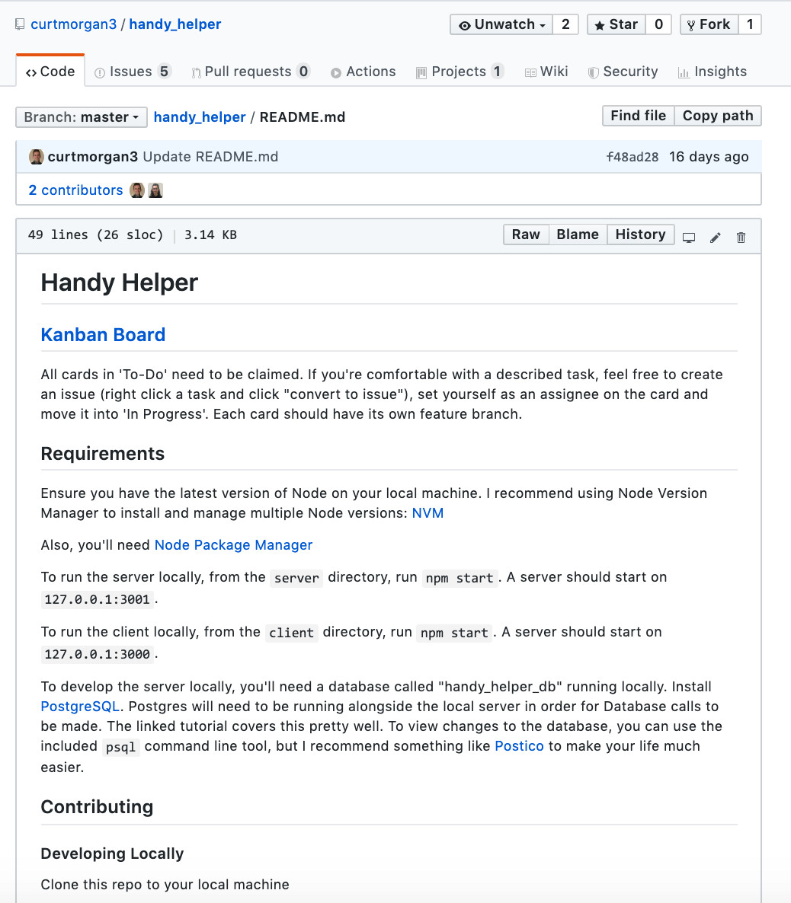

Slide 5
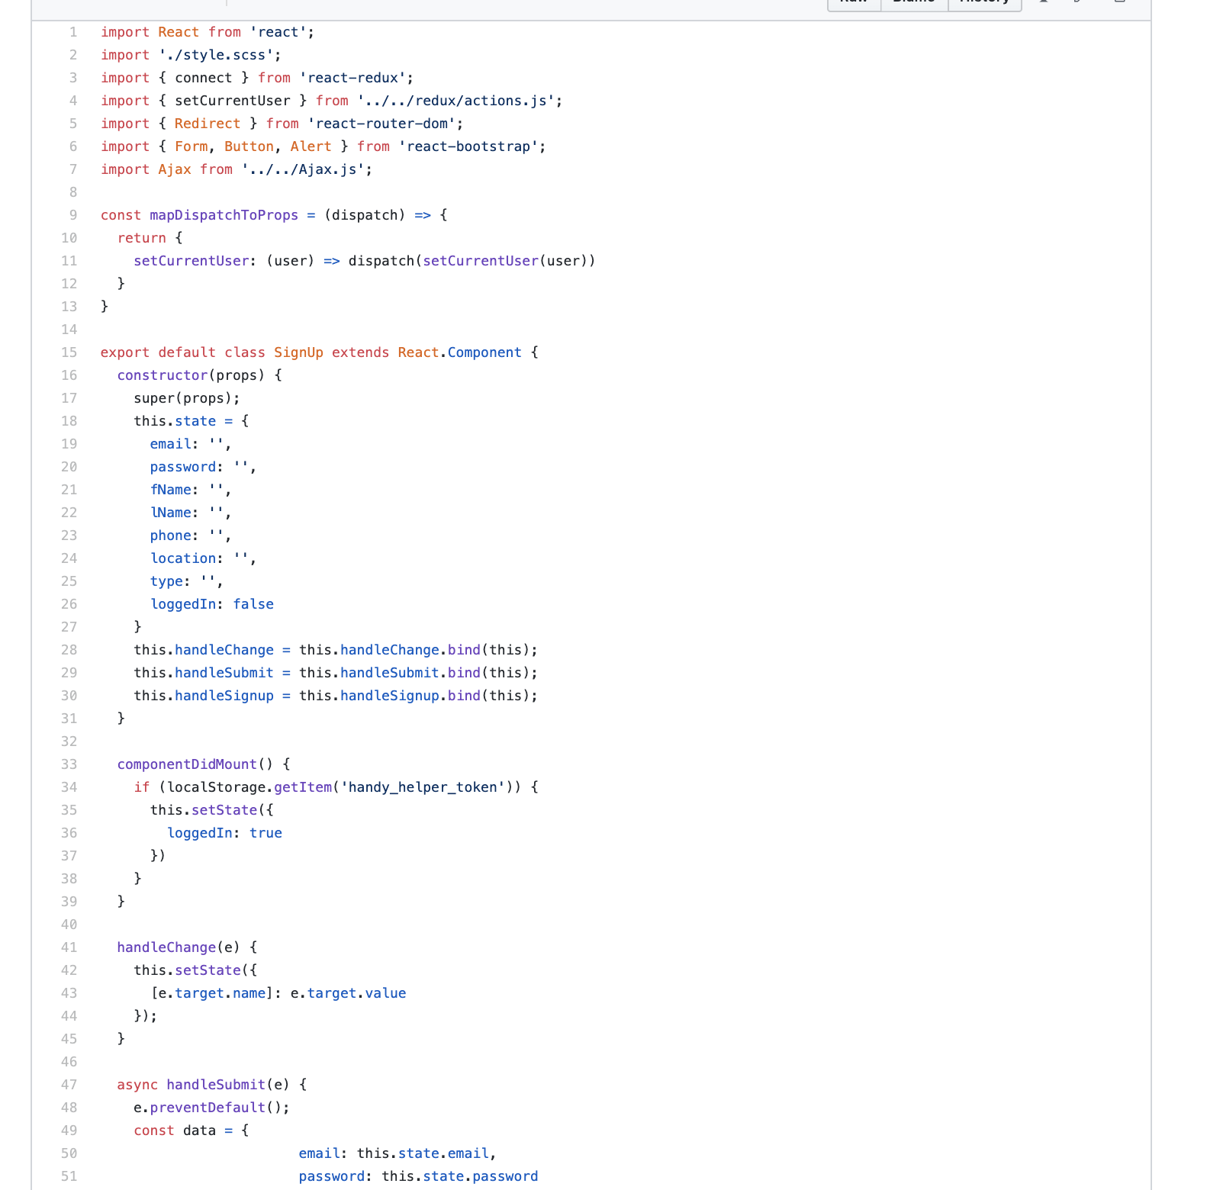

Slide 6
